Slide 1

Area of a Triangle
Exercise 11 A and 11 B

Slide 2
Area of a Triangle
You already know the formula for the area of a triangle.

Slide 3
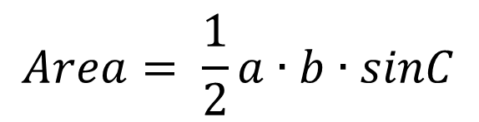
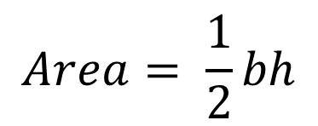

Area of a Triangle
You already know the formula for the area of a triangle.
$$Area= \frac{1}{2}bh$$
A
Using the sine ratio:
$$h=b∙sinC$$
b h c
Therefore:
$$Area= \frac{1}{2}a∙b∙sinC$$
C B
a

Slide 4
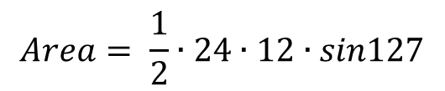

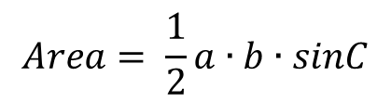
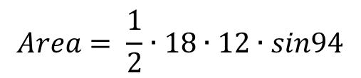
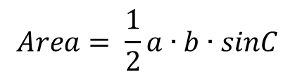

Try It Out
Determine the area of the triangle:
B
C
18
127°
24
C
12
94°
A B
12
$$Area= \frac{1}{2}a∙b∙sinC$$
A
$$Area= \frac{1}{2}∙24∙12∙sin127$$
$$Area= \frac{1}{2}a∙b∙sinC$$
$$Area=115 {units}^{2}$$
$$Area= \frac{1}{2}∙18∙12∙sin94$$
$$Area=107 {units}^{2}$$

Slide 5
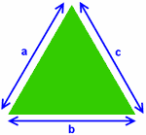
The Heron’s formula is used to find the area of a triangle using its sides.
Heron’s Formula
The formula is credited to Heron, who was the “Hero of Alexandria”; a proof can be found in his book, Metrica written in 60 A.D. It was discovered by the Chinese published in Shushu Jiuzhang.

Slide 6

Heron’s Formula
A, B, and C are the sides of the triangle.
“s” is half the triangle’s perimeter

Slide 7

Heron’s Formula
After finding “s,” you use Heron’s formula to find the area of a triangle.

Slide 8
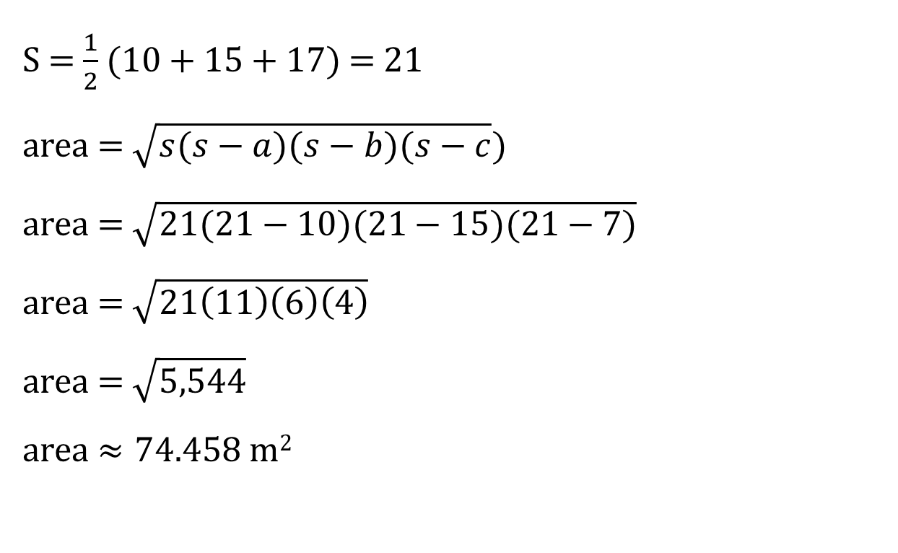
Examples:
What is the area of the triangle with sides of length 10 m, 15 m, and 17 m?
S = $\frac{1}{2}$ (10 + 15 + 17) = 21
area = $\sqrt{s(s−a)(s−b)(s−c})$
area = $\sqrt{21(21−10)(21−15)(21−7)}$
area = $\sqrt{21\left(11\right)\left(6\right)\left(4\right)}$
area = $\sqrt{5,544}$
area $≈74.458$ m²

Slide 9
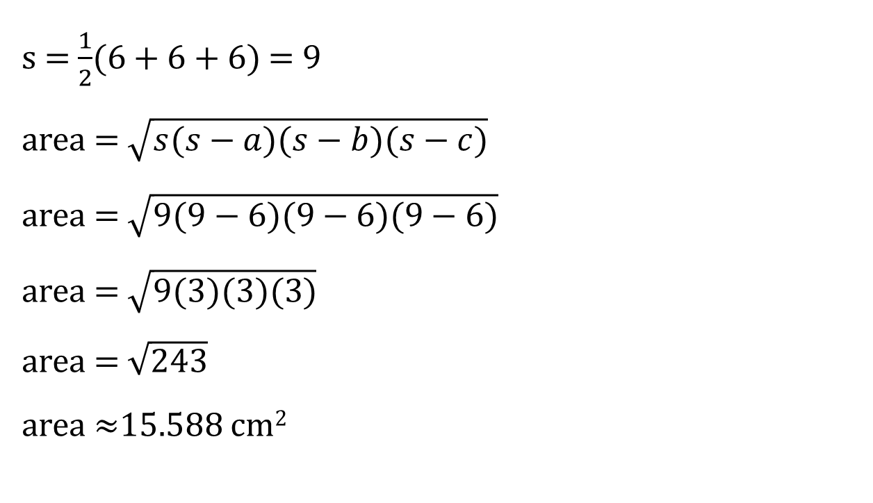
Examples
2) What is the area of an equilateral triangle with all sides 6 cm in length?
s = $\frac{1}{2}$(6 + 6 + 6) = 9
area = $\sqrt{s(s−a)(s−b)(s−c)}$
area = $\sqrt{9(9−6)(9−6)(9−6)}$
area = $\sqrt{9(3)(3)(3)}$
area = $\sqrt{243}$
area $≈$15.588 cm²

